Slide 1
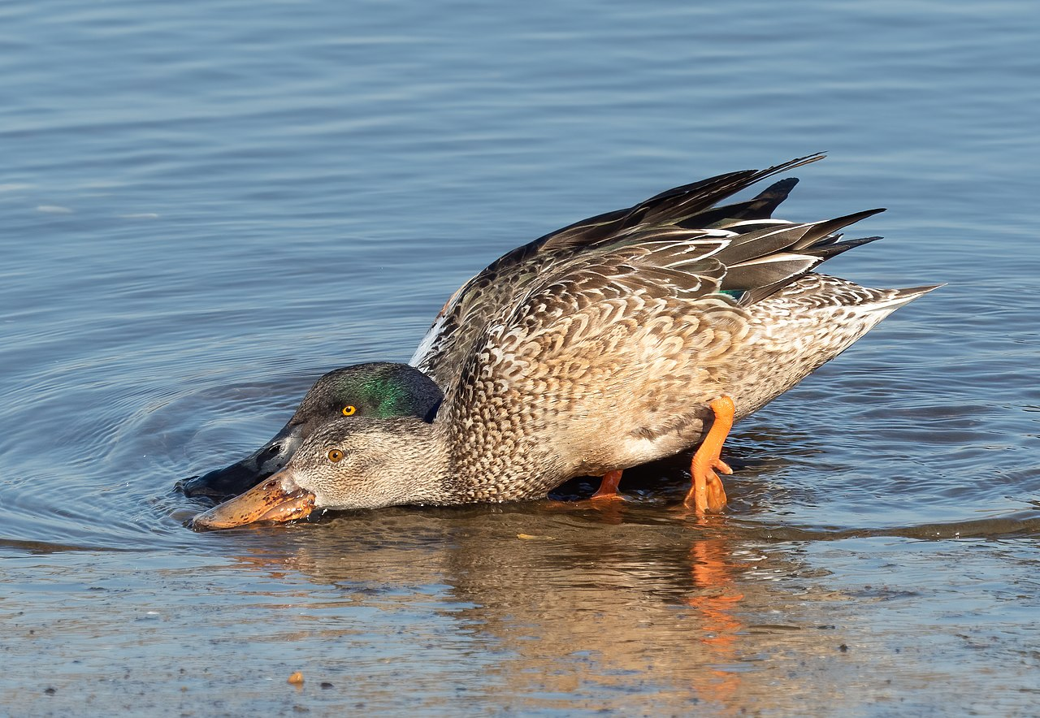

Time Budget of Feeding in Northern Shovelers
at Mueller Park, Austin, Texas
Sergio Carranco | Kim Luong | Peter Zhang
Discussion Section: Friday 9–10 AM
Notes:
Hello everyone. My name is Kim Luong, and I’ll be presenting our group’s research project on the foraging behavior of Northern Shovelers observed at Mueller Lake Park here in Austin, Texas.
This project was conducted by Sergio Carranco, Kim Luong, and Peter Zhang.

Slide 2

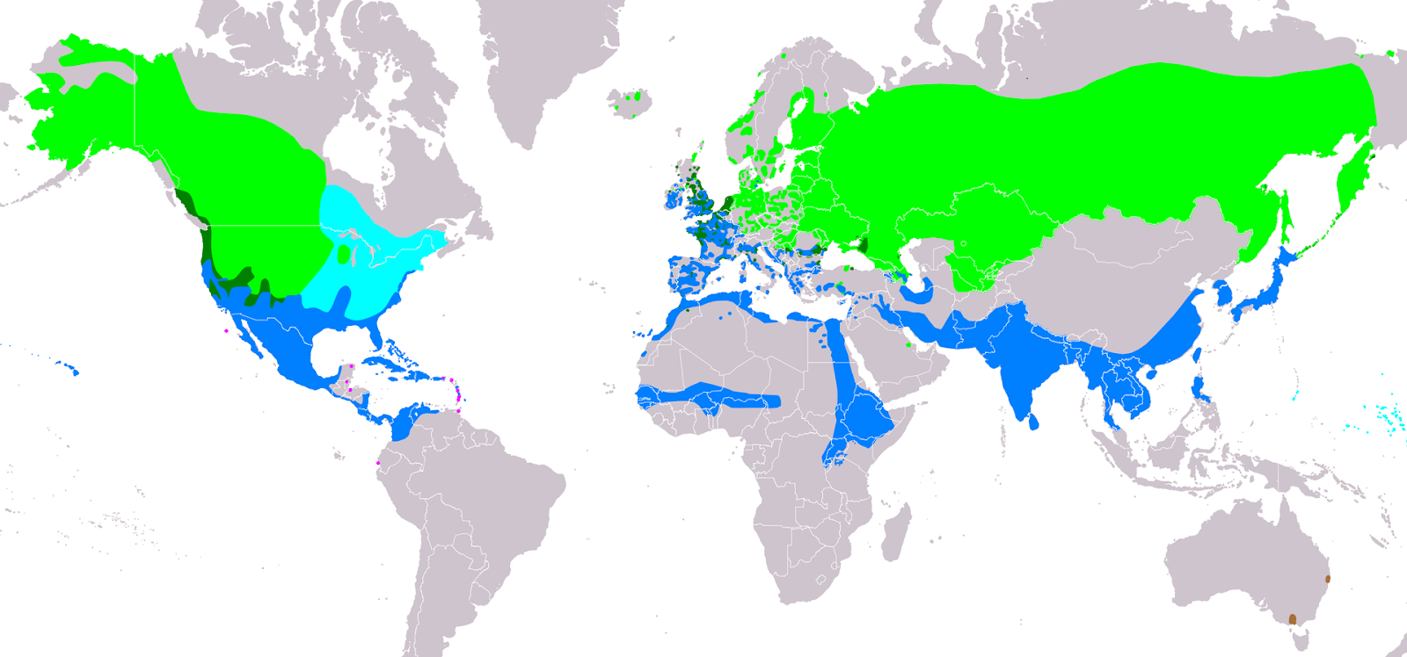
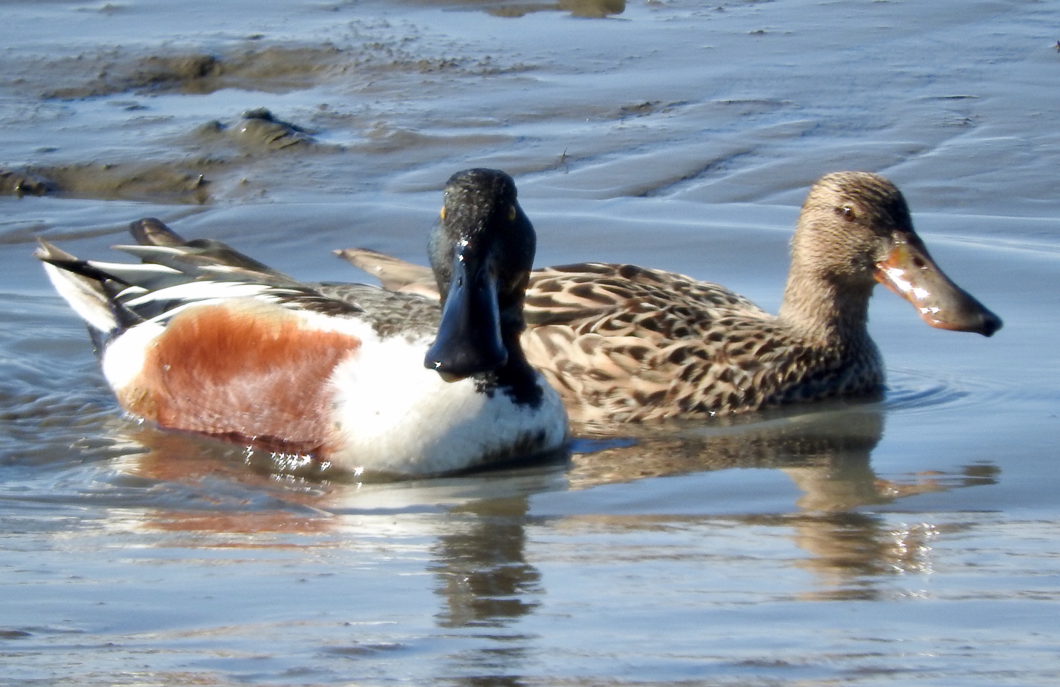
Introduction – Background on the Study Species
The Northern Shoveler (Anas clypeata) aka Dabbling duck (broad, spatula-shaped bill)
Distribution map of Northern Shovelers
Found widely across the Northern Hemisphere
Migrants (traveling as far south as Australia during the winter)
Breeding season starting in April
Exhibit strong Sexual Dimorphism
Male (left): iridescent green head, white breast, chestnut flanks
Female (right): mottled brown throughout
Notes:
So, who exactly is the Northern Shoveler? Scientifically known as Anas clypeata, the Northern Shoveler is a dabbling duck recognizable by its broad, spatula-shaped bill, which it uses to strain water for crustaceans, plankton, and small fish. You might recognize them from Mueller Park right here in Austin, where they're a fairly common sight. Widely distributed across the Northern Hemisphere, Northern Shovelers are highly migratory, with some populations wintering as far south as Australia. The species exhibits strong sexual dimorphism, which is when males and females look noticeably different. Males display a striking iridescent green head, white breast, and chestnut flanks, while females are mottled brown throughout. Their breeding season begins in April, shortly after the window of this study.

Slide 3
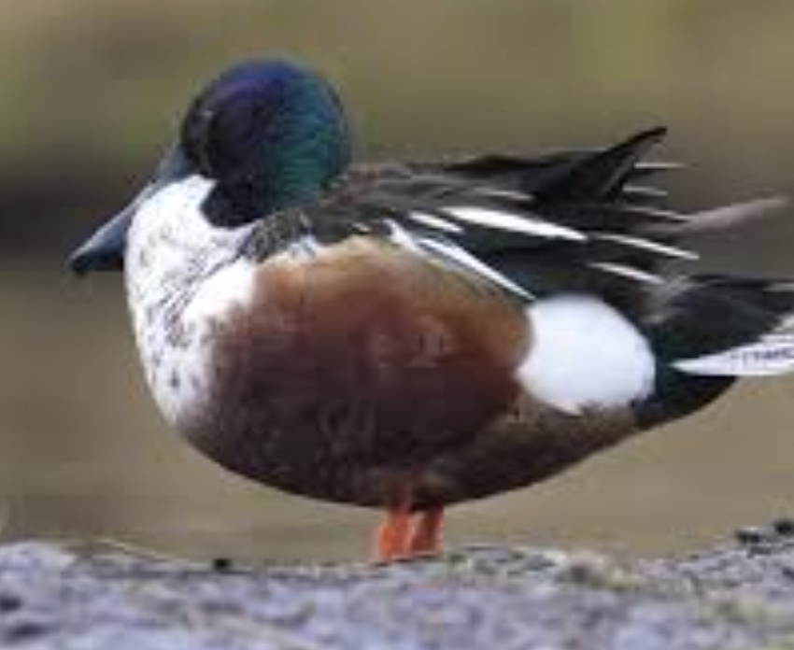
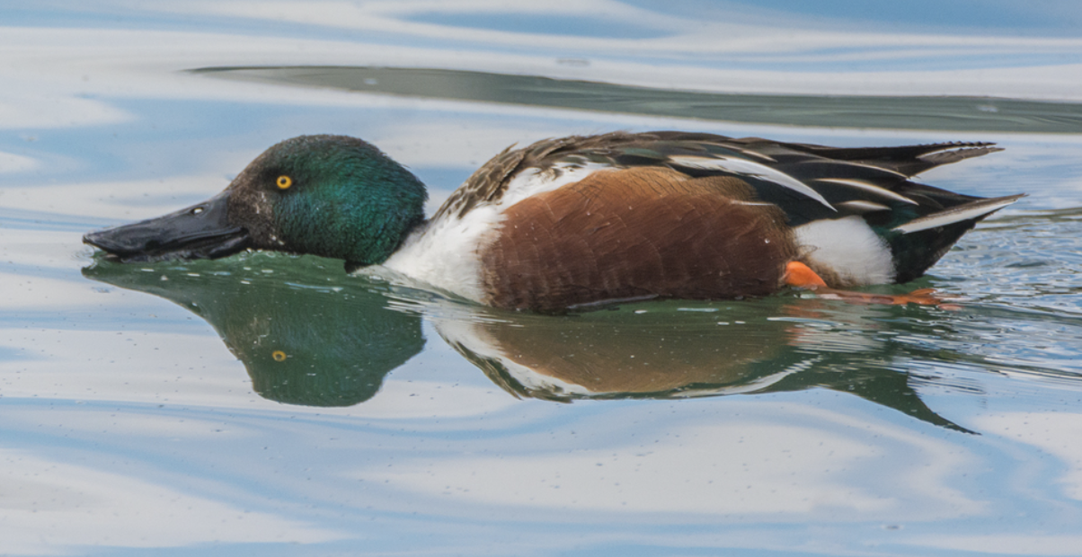
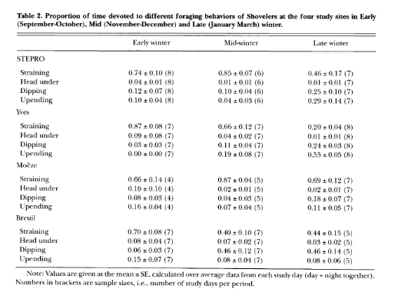
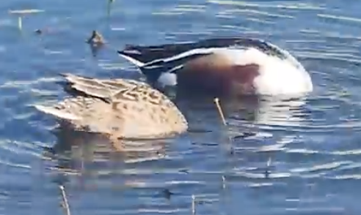
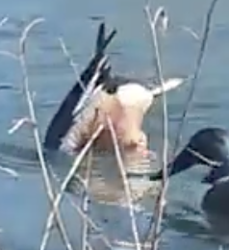
Introduction – Foraging Behaviors
60% foraging time (Guillemain et al., 2000)
Pecking – a sharp forward head movement toward small particles on the ground, sustained for ≥ 5s
Dabbling – forward swimming with the bill skimming the water surface to filter food particles
Prior research
The time budgets for each of these behaviors differs between sex (Rose et al., 2022).
These time budgets also change during breeding season (Afton, 1979).
Dipping – rapid submersion of the head into the water
Dabbling – full submersion of the head and foreparts with the tail raised vertically in the air
Notes:
Northern Shovelers are unique feeders. They use their wide, spoon-shaped bills to strain water and capture crustaceans, plankton, and small fish.
Northern Shovelers employ four primary foraging behaviors that were the focus of this study:
Pecking — a sharp forward head movement toward small particles on the ground or water surface, sustained for at least 5 seconds.
Dabbling — forward swimming with the bill skimming the water surface to filter food particles.
Dipping — rapid submersion of the head into the water.
Upending — full submersion of the head and foreparts with the tail raised vertically in the air.
Prior literature has established that the relative frequency of these behaviors varies between sexes and seasons. Afton (1979) found that females spent significantly more time foraging than males during the early breeding season, while Guillemain et al. (2000) documented that straining (analogous to dabbling in this study) represented the dominant foraging mode in wintering shovelers in France, accounting for over 60% of all foraging time.

Slide 4
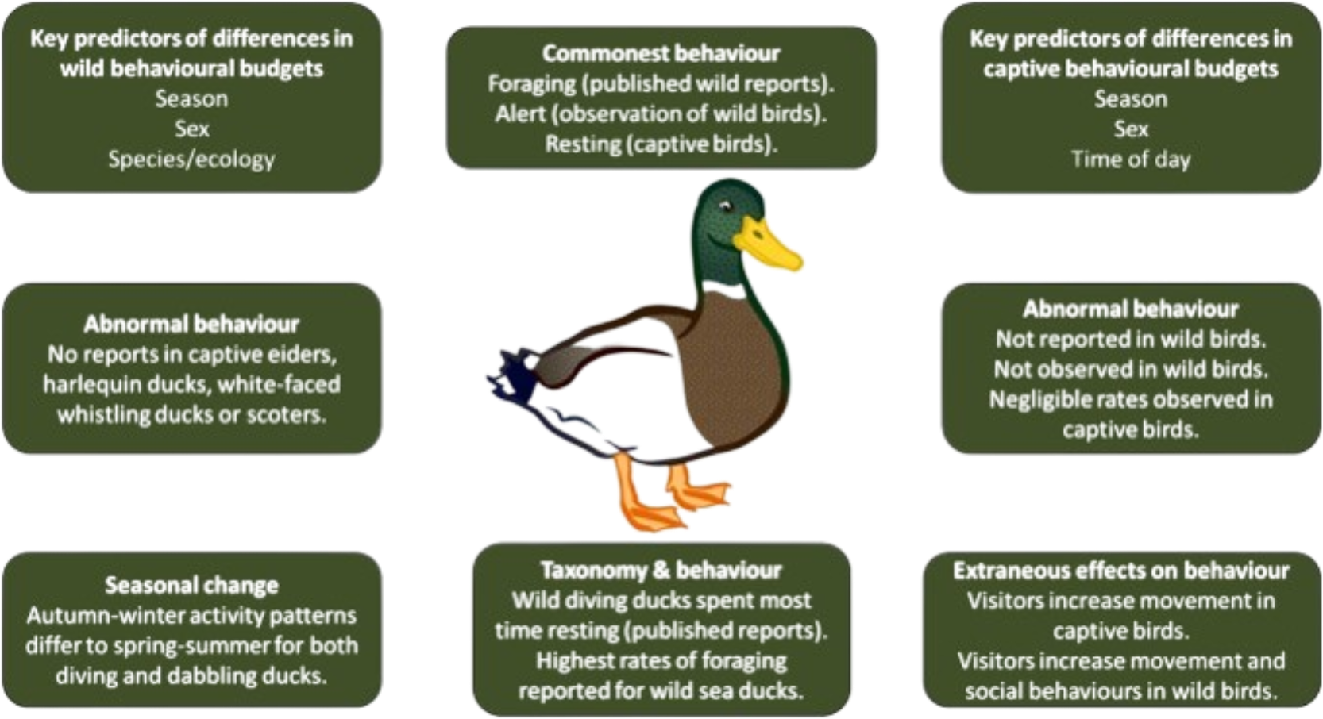
Significance – Why Does It Matter?
They are not threatened, but their population is declining.
Habitat Loss → Parks become more important → Human Presence → Effects on Northern Shovelers
Feeding is important! What affects feeding?
Breeding Season
Temperature, weather, or climate
Human presence and interaction
Time Budget
Source: Rose, P. et al. (2022). Evaluation of the Time-Activity Budgets of Captive shovelers (Anatidae) Compared to Wild Counterparts. ScienceDirect, 251. https://doi.org/10.1016/j.applanim.2022.105626.
Notes:
Now, why is studying foraging behavior important? Northern Shovelers are not currently threatened, but their population is declining, largely due to habitat loss. As natural habitats shrink, parks like Mueller become increasingly critical refuges. But parks come with something natural habitats don't — a constant human presence. And that raises an important question: does human activity affect how shovelers feed?
Feeding is fundamental to their survival and reproduction, so anything that disrupts their foraging efficiency has real biological consequences. Our study aimed to understand what's driving changes in foraging patterns — is it the time of day, the sex of the bird, or the human activity around them?

Slide 5
Research Question – How does foraging behavior differ throughout different times of the day? Is this due to the time of the day, the sex of the bird, or other factors?
Possible Independent Variables
Time of Day
Sex
Age
Possible Dependent Variables
Frequency of specific feeding behaviors
Possible Environmental Variables
Temperature
Presence of many humans
Human feeding of shovelers
Time of year
Weather
Noise
Health of ducks
Notes:
That brings us to our research question: How does foraging behavior differ throughout different times of the day? Is this due to the time of day, the sex of the bird, or other factors?
We identified our key variables as follows:
Independent variables: Time of day (morning, afternoon, evening) and sex (male or female)
Dependent variable: The frequency of each of the four foraging behaviors per 10-minute observation interval
Environmental variables we tracked: Temperature, human presence, human feeding of the ducks, time of year, weather, and noise

Slide 6
Hypothesis – Due to human interference throughout the day, foraging frequencies of Northern shovelers will be affected regardless of sex.
What can we expect out of the different types of foraging behaviors in terms of frequency and type?
“Foraging Behavior and Habitat Choice of Wintering Northern Shoveler in a Major Wintering Quarter in France” (Guillemain et al., 2000)
How do shovelers behave differently in the presence of humans?
Females spend more time foraging than males. (Afton, 1979)
Human interaction is expected to offset this natural difference. (Rose et al., 2022)
Will breeding season be an important factor? If so, in what ways?
Pre-breeding season (Jan - Mar): 25% feeding (Webb and Brotherson, 1988)
Early breeding season (Apr - Jul): 60% feeding (Afton, 1979)
How can we expect sex to affect feeding behaviors? How will this interact with breeding season?
Time budget for foraging decreased for paired shovelers throughout breeding season. (Afton, 1979)
Notes:
Our biological hypothesis was: Due to human interference throughout the day, foraging frequencies of Northern Shovelers will be affected regardless of sex.
This hypothesis was motivated by two lines of evidence. First, Afton (1979) established that females naturally forage more than males, while males spend more time in alert postures. Second, Rose et al. (2022) demonstrated that human visitors reduce duck alertness in captive and semi-captive settings, such as a public park with frequent visitors. We reasoned this effect would offset the natural sex difference in foraging time.
We also drew on documented foraging behavior of wintering Northern Shovelers in France, and Webb and Brotherson (1988), who reported that shovelers spent about 25% of their time feeding during pre-breeding months — a window that closely matches our February–March study period.
Additionally, Guillemain et al. (2000) described daily variation in foraging location and behavior in wild shovelers, and we hypothesized that human activity throughout the day would modulate this variation in ways not observed in undisturbed populations.

Slide 7

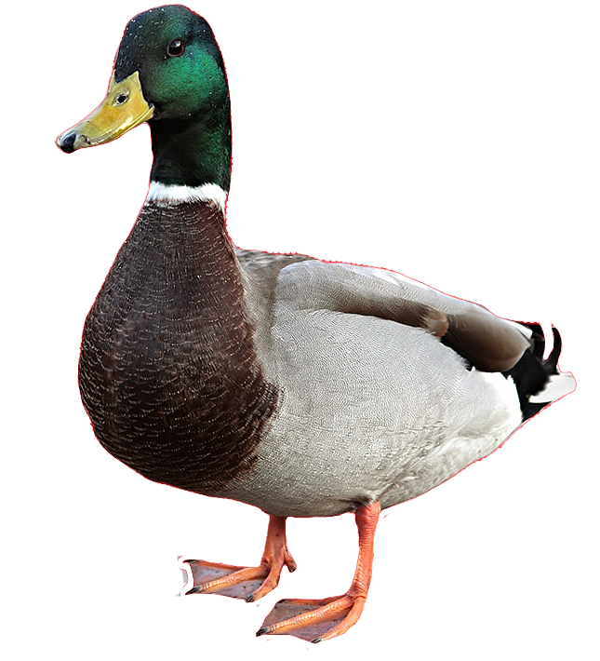
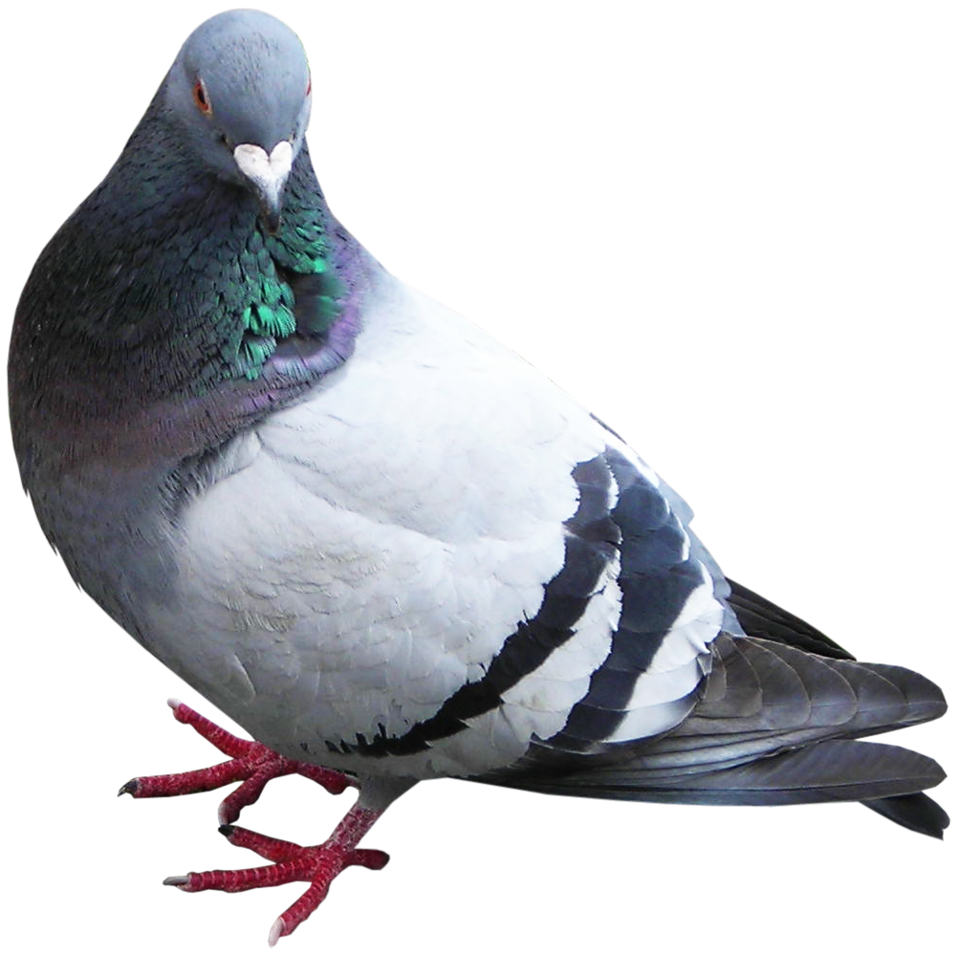
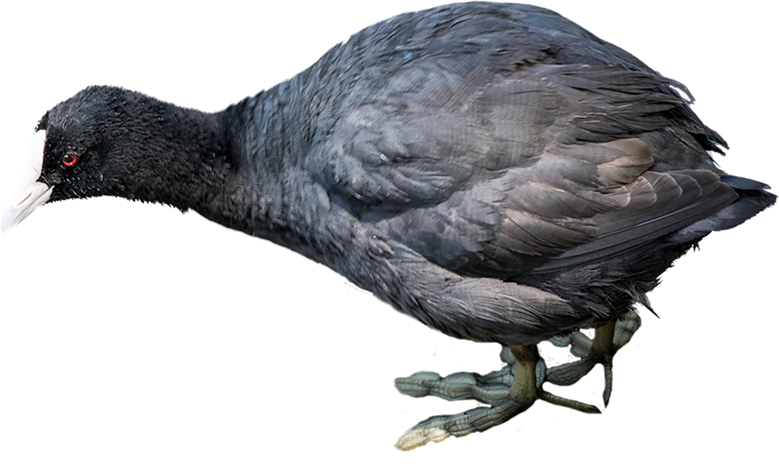
Methods
Where: Mueller Lake Park in Austin, Texas
When: Feb 23 - Mar 6 from 9 AM – 7 PM
Experiment Variables:
a) Independent variable: Time of Day (ordinal: morning (9 AM–12 PM), afternoon
(12–3 PM), and evening (3–7 PM))
Sex (nominal: female and male)
b) Dependent variable: Frequency of Feeding Behaviors per 10 minutes
(Scan Sampling (Lehner, 1998))
Environmental Variables Tracked:
Temperature (continuous – hourly from weather.com), human presence (nominal), proximity to breeding season (ordinal), and weather conditions
Sample Size: varies 0 – 50
Other Species: waterfowl species (e.g., mallards (Anas platyrhynchos), pigeons (Columba livia), American coots (Fulica americana))
Notes:
Observations were conducted at Mueller Lake Park (Austin, Texas) from February 23 to March 6. This site was selected because it supports a reliably visible Northern Shoveler population during the late winter period and provides open sightlines for scan sampling. Observations took place daily from 9:00 AM to 6:00 PM, with data collected across three time blocks: morning (9 AM–12 PM), afternoon (12–3 PM), and evening (3–7 PM).
Scan sampling (Lehner, 1998) was used because all four target behaviors are state behaviors with clear, observable onset and offset points. This method enabled simultaneous recording of behavior across all visible individuals at a given moment, making it efficient for tracking population-level time budgets across large, variable group sizes. At 10-minute intervals, observers scanned all visible Northern Shovelers and recorded the count of individuals of each sex performing each of the four foraging behaviors. Six scan samples were collected per observation hour, and observers documented their presence via timestamped photographs at each site visit.
Morning sessions were characterized by cooler temperatures (64–68°F) and lower numbers of park visitors. Afternoon and evening sessions were warmer (73–78°F) and coincided with higher human foot traffic.
Shoveler sample sizes ranged dramatically, from zero to as many as 50 birds on a given day. While other waterfowl species — including mallards, American coots, and pigeons — were present at the site, no systematic effects of these species on shoveler behavior were observed.

Slide 8
Predictions
Based on the biological hypothesis and prior literature, the following predictions were made prior to data collection:
1. The time budgets of foraging behaviors should not differ greatly between male and female Northern shovelers.
2. The time budgets of foraging behaviors should differ greatly throughout the different times of day (morning, afternoon, and evening).
3. The dabbling behavior will be the most frequent foraging behavior.
Notes:
Before analyzing our data, we made three key predictions:
The time budgets of foraging behaviors would not differ significantly between male and female shovelers, as human presence in the park was expected to neutralize the naturally higher female foraging rate documented by Afton (1979)
The time budgets of foraging behaviors would differ significantly across the three time periods — driven by human activity and the shovelers' own daily rhythms.
Dabbling would be the most frequent foraging behavior — consistent with Guillemain et al. (2000), who found straining (what we call dabbling) represented over 60% of feeding behavior in wild shovelers.

Slide 9

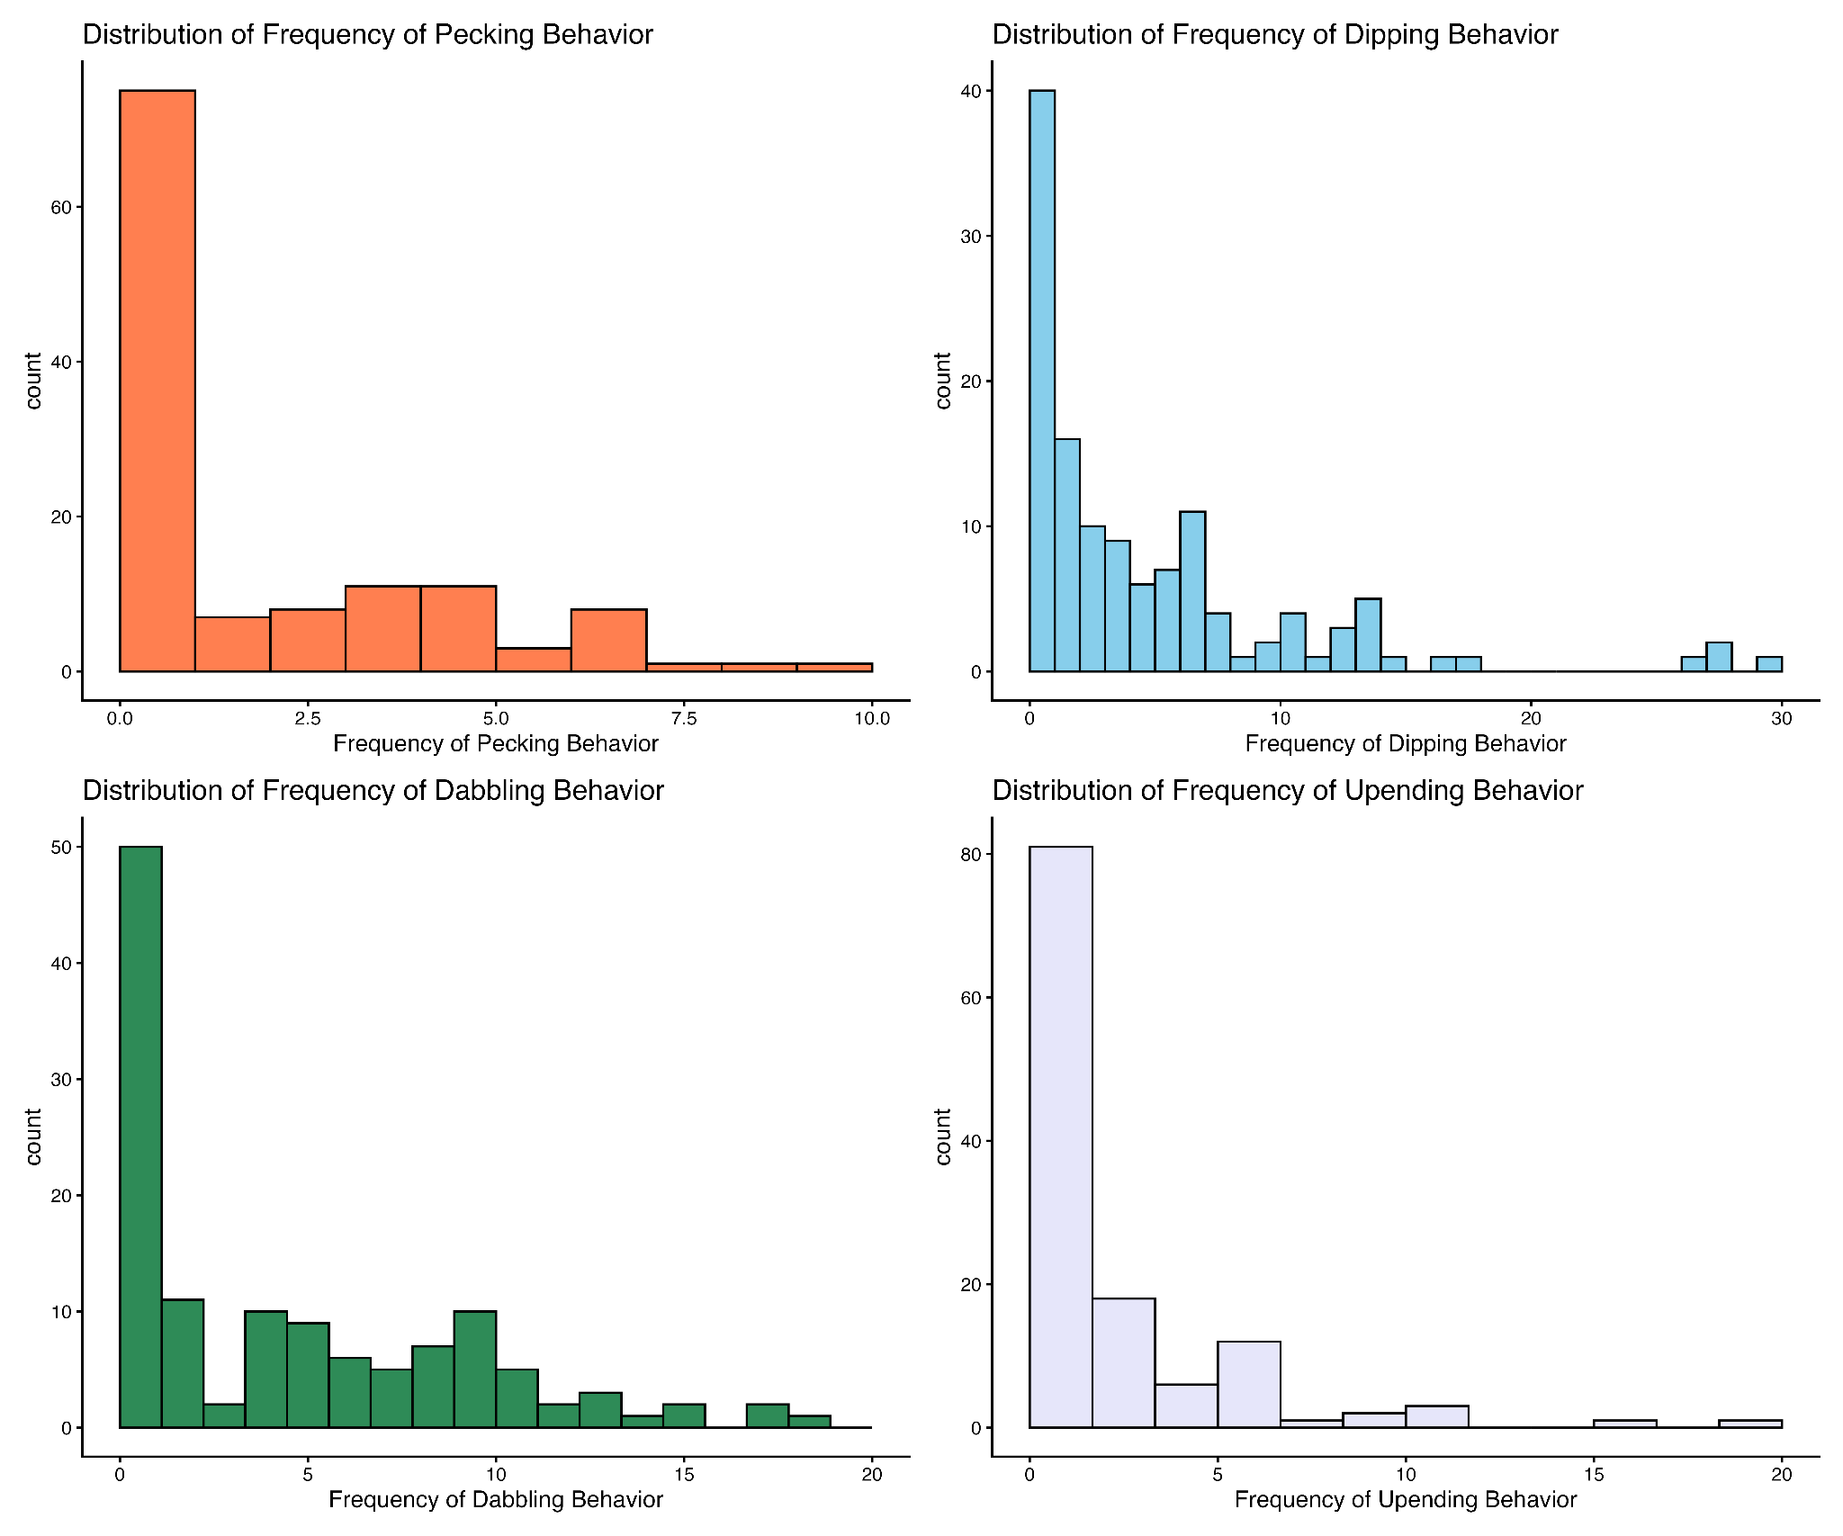
Results – Data Distribution (Normality Summary)
Behavior | W | p-value
pecking | 0.72116 | 3.66E-14
dabbling | 0.7334 | 7.84E-14
dipping | 0.86133 | 1.68E-09
upending | 0.73759 | 1.17E-13
Table 1. Results of the Shapiro-Wilk’s Normality Test
Trends:
All histograms are skewed to the right.
All p-values are less than 0.05.
Figure 1. Histograms showing the distribution of frequency of the four different types of foraging behaviors.
Notes:
Before running our main statistical tests, we first checked whether our data followed a normal distribution using the Shapiro-Wilk test. The results are shown here in Table 1.
All four behaviors — pecking, dabbling, dipping, and upending — had p-values far below 0.05, and the corresponding histograms in Figure 1 all show a strong right skew. This means the normality assumption was violated, which directed us toward non-parametric statistical tests for our main analyses.

Slide 10
Results – Sex Comparison (Summary Statistics)
 | pecking |  | dabbling |  | dipping |  | upending
Sex | mean | sd | mean | sd | mean | sd | mean | sd
male | 0.8095238 | 1.342918 | 2.571429 | 3.0553 | 2.365079 | 3.158742 | 1.079365 | 1.998412
female | 0.6746032 | 1.130164 | 1.793651 | 2.263864 | 2.007937 | 3.031821 | 0.8809524 | 1.562599
Wilcox Test: | W = 134036 |  | p-value = 0.1
Table 2. Summary Statistics of Frequency of Foraging Behaviors Between Sex
Trends:
The mean of the frequency between male and female shovelers are similar for each of the foraging behaviors observed
The standard deviation or the spread of the data are also similar for each of the foraging behaviors observed.
The frequency and standard deviation of the dabbling and dipping behavior is greater than the frequency of the pecking and upending behavior.
Statistical Test - Wilcoxon-Mann Whitney test:
2 separate and independent groups
normality assumption is violated.
Notes:
Now for the main results. First, we looked at whether foraging behavior differed between males and females.
Table 2 summarizes the mean and standard deviation of each foraging behavior broken down by sex. You can see that the values are quite close between males and females across all four behaviors. The means for dabbling and dipping were higher than pecking and upending in both sexes.
To test this statistically, we used the Wilcoxon-Mann Whitney test, which is appropriate for two independent non-normal groups. The result: W = 134,036, p-value = 0.1. Since p > 0.05, we fail to reject the null hypothesis — there is no significant difference in foraging frequency between males and females.

Slide 11
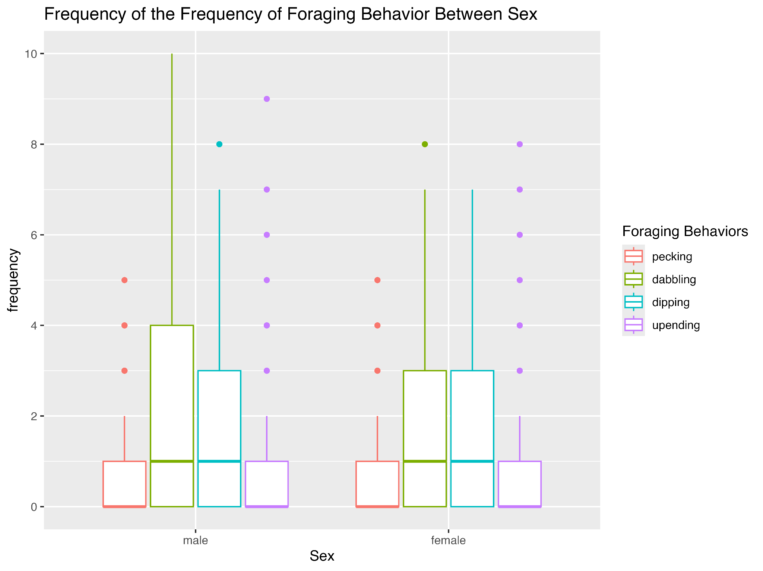
Results – Sex Comparison (Graph)
Figure 2. Box and whisker plots displaying the frequency of foraging behaviors between the sex of the Northern shovelers
Independent Variable:
Sex
Female
Male
Dependent Variable:
Frequency of Foraging Behaviors
The dependent variable is discrete.
Notes:
Figure 2 shows the box-and-whisker plots for foraging behavior frequency broken down by sex. As you can see visually, the distributions overlap considerably, and the medians are similar across all four behaviors for males and females. This is consistent with our statistical result — sex did not significantly predict foraging frequency.

Slide 12
Results – Time of Day Comparison (Summary Statistics)
 | pecking |  | dabbling |  | dipping |  | upending
Time of Day | mean | sd | mean | sd | mean | sd | mean | sd
morning | 0.5952381 | 1.498935 | 2.404762 | 3.901591 | 1.142857 | 1.920003 | 0.6190476 | 1.188407
afternoon | 0.8571429 | 1.675817 | 2.809524 | 3.307332 | 2.5 | 3.140996 | 1 | 1.861025
evening | 3 | 2.419434 | 7.880952 | 4.484131 | 9.47619 | 7.249014 | 4.238095 | 4.326941
Kruskal Wallis Test: | chi-squared = 150.26 |  | df = 2 |  | p-value < 2.2e-16
Table 3. Summary Statistics of Frequency of Foraging Behaviors Between Time of Day
Trends:
The frequency of the four different types of foraging behaviors observed increases as the day progresses.
The frequency of the dabbling and dipping behavior is greater than the frequency of the pecking and upending behavior.
Statistical Test - Kruskal-Wallis test:
3/+ independent groups
normality assumption is violated.
Notes:
Next, we looked at how foraging behavior changed throughout the day.
Table 3 shows a clear trend: the frequency of all four foraging behaviors increased steadily from morning to evening. For example, dabbling had a mean of about 2.4 in the morning, 2.8 in the afternoon, and 7.9 in the evening. The same pattern holds for dipping, pecking, and upending.
To test this, we used the Kruskal-Wallis test, appropriate for three or more independent non-normal groups. The result: chi-squared = 150.26, df = 2, p-value < 2.2e-16 — a highly significant result. The null hypothesis is rejected: foraging frequency does differ significantly by time of day.

Slide 13
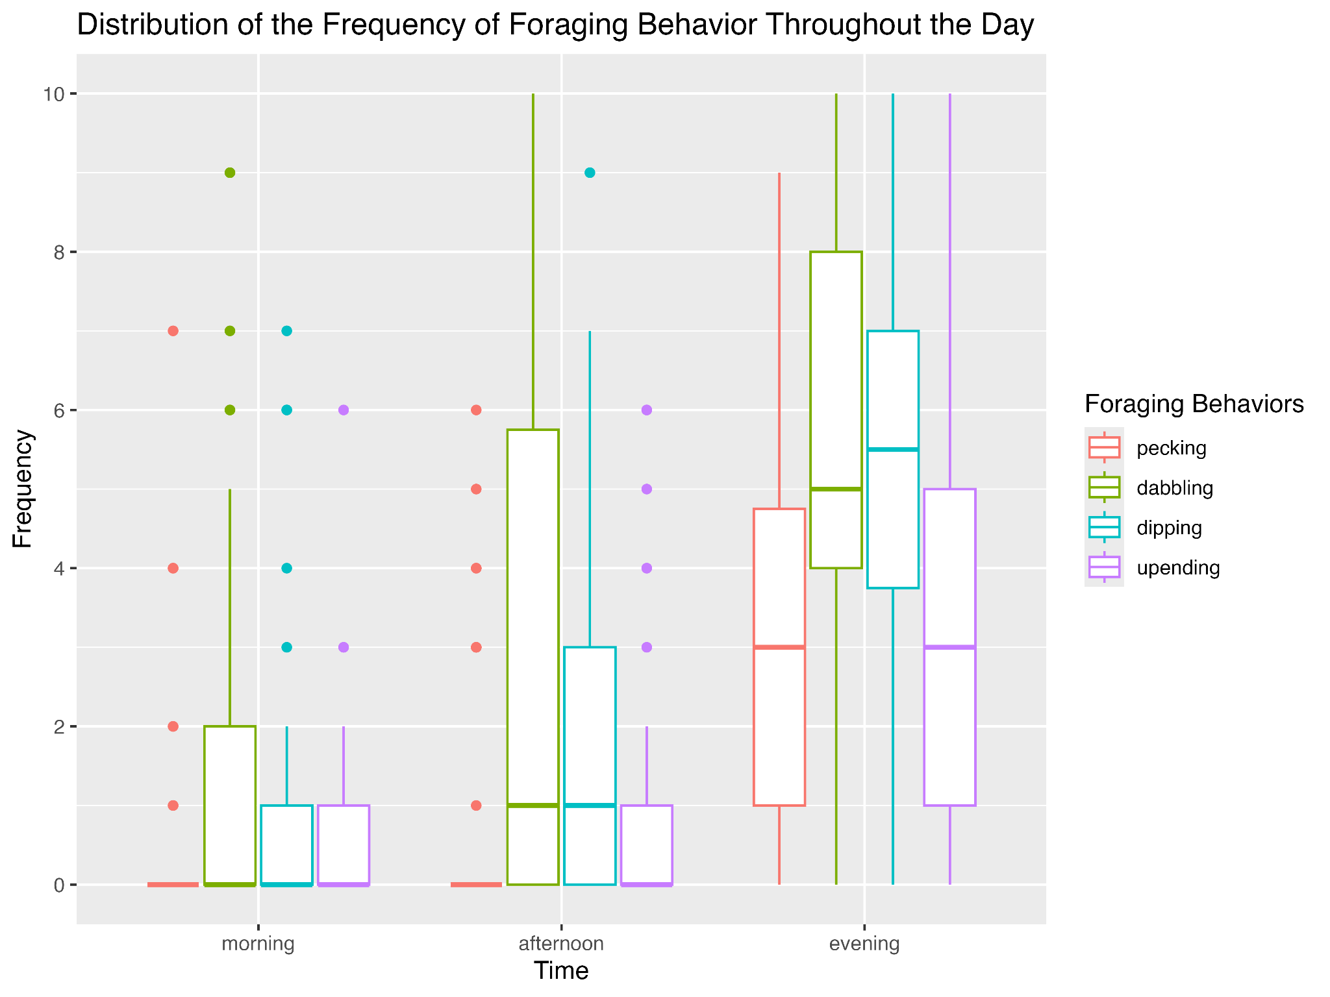
Results – Time of Day Comparison (Graph)
Figure 3. Box and whisker plots displaying the frequency of foraging behaviors throughout the three different times of day.
Independent Variable:
Time of Day
morning
afternoon
evening
Dependent Variable:
Frequency of Foraging Behaviors
The dependent variable is discrete.
Notes:
Figure 3 visualizes this clearly with box-and-whisker plots by time of day. Each of the four foraging behaviors shows a gradual increase from morning to afternoon to evening, with the evening showing notably higher medians and wider spreads. The statistical significance we found is plainly visible in these distributions.

Slide 14
Results – Paired Comparisons Between Behaviors
Data | t | df | p-value | CI | mean difference
pecking and dabbling | -8.1767 | 125 | 2.79E-13 | -3.578269, -2.183636 | -2.880952
pecking and dipping | -6.1191 | 125 | 1.12E-08 | -3.823248, -1.954530 | -2.888889
pecking and upending | -1.8644 | 125 | 0.06461 | -0.98167582, 0.02929487 | -0.4761905
dabbling and dipping | -0.016945 | 125 | 0.9865 | -0.9348864, 0.9190134 | -0.007936508
dabbing and upending | 6.2277 | 125 | 6.60E-09 | 1.640548, 3.168976 | 2.404762
dipping and upending | 5.0336 | 125 | 1.64E-06 | 1.464063, 3.361334 | 2.412698
Table 4. Summary Statistics of Paired t-test Between Foraging Behaviors
Trends:
There is a significant difference between the frequency of pecking and dabbling, the frequency of pecking and dipping, the frequency of dabbling and dipping, the frequency of dabbling and upending, and the frequency of dipping and upending.
There is no significant difference between the frequency of pecking and upending as well as between the frequency of dabbling and dipping.
Northern shovelers peck and upend the least to forage, and they dabble and dip the most to forage.
Statistical Test - Paired t-test: to determine whether the mean difference between the two sets of measurements is statistically significant or not.
Notes:
Finally, we compared the frequencies of the four foraging behaviors against each other using paired t-tests. The results are summarized in Table 4.
There is a significant difference between the frequency of pecking and dabbling, the frequency of pecking and dipping, the frequency of dabbling and dipping, the frequency of dabbling and upending, and the frequency of dipping and upending. There is no significant difference between the frequency of pecking and upending as well as between the frequency of dabbling and dipping.
The negative confidence intervals for pecking-vs-dabbling and pecking-vs-dipping show pecking was less frequent. The positive CIs for dabbling-vs-upending confirm dabbling was more frequent than upending.
Also, dabbling and dipping were the most frequent behaviors; pecking and upending were the least frequent.

Slide 15
Discussion – Biological Hypothesis Assessment
Results - Predictions
Based on the Wilcoxon-Mann Whitney test, there is no significant difference between the frequency of the foraging behavior between the sex of Northern shovelers, which proves our original prediction to be true (p-value = 0.1).
Based on the Kruskal-Wallis test, there is a significant difference between the frequency of the foraging behavior throughout the day, which also proves our original prediction to be true (p-value < 2.2e-16).
Based on the paired t-test, the pecking and upending behaviors were significantly different from the dabbling and dipping behaviors, in which dabbling and dipping were more frequent than pecking and upending. This disproves our prediction that only dabbling would be the most frequent foraging behavior for Northern shovelers.
Results - Biological Hypothesis
Both parts of our biological hypothesis were supported.
Notes:
Three predictions were made prior to data collection. Two were confirmed and one was partially disproved.
The Wilcoxon-Mann Whitney test supported the prediction that foraging frequency would not differ significantly between males and females. Even though females are known to forage more than males in the wild, the similar rates we observed align with Rose who found that captive ducks show reduced alertness around humans, which may have equalized foraging rates between sexes.
The Kruskal-Wallis result confirmed a significant increase in foraging frequency across the day. Foraging was lowest in the morning and highest in the evening, aligning with Guillemain’s conclusion that foraging activity and location shift throughout the day, partly in response to prey distribution. An additional factor observed in this study was that shovelers were predominantly asleep during morning hours — a confounding variable not anticipated in the original hypothesis, and there was an inverse relationship between human presence and foraging frequency.
While dabbling was among the most frequent behaviors, it was statistically indistinguishable from dipping. Our original prediction was too narrow; the data support a revised conclusion that both dabbling and dipping function as the primary foraging strategies, with pecking and upending serving as secondary behaviors. However, the difference may reflect the role of human feeding of the ducks at Mueller Park, which could promote shallow-water behaviors like dipping.

Slide 16
Discussion – Tinbergen's 4 Levels of Analysis
The mechanisms of the results fit into the function level of analysis.
Foraging behaviors directly impacts their ability to obtain food.
how the behavior is influenced by environmental factors
how does the time of day affect foraging
how does the presence of humans affect foraging
how does temperature affect foraging
how does breeding season affect foraging
how does sex impact fitness, and how does that fit with reproduction
Notes:
Our findings are best interpreted at the functional level of Tinbergen's (1963) four levels of analysis, which asks what adaptive value a behavior provides. Foraging directly enables energy acquisition, which underpins survival, migration, and reproductive fitness. The time-of-day variation in foraging frequency reflects how environmental factors — including temperature, prey availability, human presence, and endogenous activity cycles — interact to shape energy acquisition strategies in a park-dwelling population.
Future work could additionally examine the mechanistic level (hormonal or neurological triggers of foraging initiation), the developmental level (how individual shovelers learn to forage in the presence of humans), and the phylogenetic level (whether dabbling ducks as a group show similar park-mediated behavioral plasticity)

Slide 17
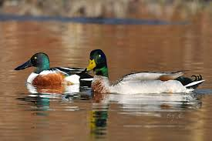
Discussion – Limitations & Follow-Up Questions
Data Collection Issues/Limitations
Sample Size Variation: There were many days with very few shovelers in the park.
Expand the time frame of the observation, so that the days without shovelers can be discarded or ignored.
Confounding Variable: The weather limited the study, in which the sample size greatly decreased during days when the cold front came.
Species Mididentification: Distinguishing Northern Shovelers from mallards was occasionally difficult at distance. (Male Northern shoveler on the left vs. male mallard on the right)
Follow Up:
Would foraging behaviors be different during breeding season?
Is there a positive correlation of number of ducks at the lake with temperature?
Notes:
Our study had some notable limitations. Sample size varied dramatically — some days had zero shovelers present, which reduced our data quality. A longer observation window would allow us to discard low-count days without losing too many usable data points.
Weather was a confounding variable — cold fronts noticeably reduced duck numbers. Future studies should either control for temperature or explicitly model it as a predictor.
Species identification was occasionally challenging from a distance, particularly distinguishing shovelers from mallards.
Key questions emerging from this study include:
Would foraging behaviors differ significantly during breeding season (April–July)? Afton (1979) found dramatically higher foraging rates at the onset of breeding, and our pre-breeding observation window may have missed important behavioral variation.
Is there a positive correlation between daily temperature and shoveler group size at the lake? Informal observations suggested fewer ducks on colder or cloudier days, but this was not formally tested.

Slide 18
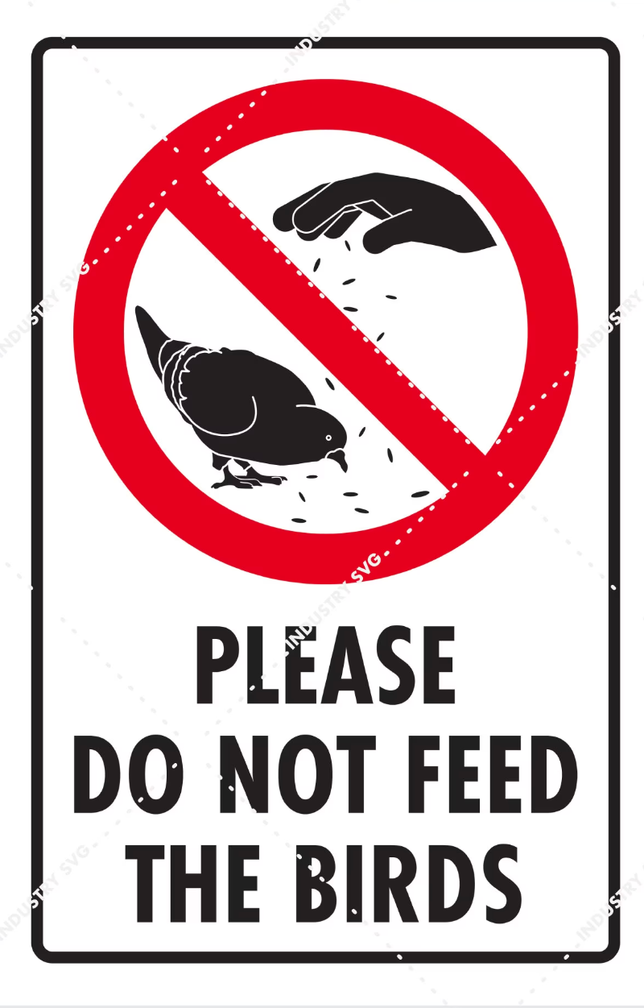
Discussion – Larger Significance & Applications
The data mainly shows that the research question needs further research as there were many confounding variables and limitations, such as weather and the fact that the ducks were often sleeping. Tentatively, the data does support the hypothesis that the common human presence in the park affects foraging behaviors throughout the day regardless of sex, in which shovelers in captivity were noted as less alert due to human visitors (Rose et al., 2022).
The behavior of ducks around humans is important because of the large numbers of ducks that live at least part of the year in parks. As such, the health of the Northern Shoveler, and ducks in general, may be greatly affected due to behavioral changes caused by human presence.
Practical management strategies: restrict feeding of ducks by visitors, establish buffer zones, and inform guidelines for managing human contact.
Notes:
The bigger picture here is one of conservation relevance. Our data tentatively support the idea that human presence in public parks influences shoveler foraging behavior, even if the causality is not fully isolated. With Northern Shoveler populations declining due to habitat loss, understanding how park environments alter their behavior matters for their long-term health.
Mueller Lake Park alone hosts over a hundred shovelers on peak days. If behavioral patterns — like reduced alertness and increased human-facilitated feeding — become the norm, it could affect their nutritional efficiency, conditioning for migration, and ultimately population fitness.
Practical management strategies based on these findings include:
Restricting duck feeding by park visitors during critical foraging periods, as supplementary food likely alters natural foraging behavior.
Establishing buffer zones that limit human approach distance to resting and nesting areas, particularly during morning hours when birds are inactive.
Applying these findings to captive breeding programs to calibrate appropriate levels of human contact during rearing.

Slide 19
Literature Cited
Afton, A. (1979). Time Budget of Breeding Northern shovelers. The Wilson Bulletin. JSTOR, 91, 42–49. http://www.jstor.org/stable/4161165.
Guillemain, M., Fritz, H., Guillon, N. (2000). Foraging Behavior and Habitat Choice of Wintering Northern Shoveler in a Major Wintering Quarter in France. Waterbirds: The International Journal of Waterbird Biolog. JSTOR, 23, 353-363. https://doi.org/10.2307/1522173.
Rose, P., Roper, A., Banks, S., Giorgio, C., Timms, M., Vaughan, P., Hatch, S., Halpin, S., Thomas, J., O’Brien, M.(2022). Evaluation of the Time-Activity Budgets of Captive shovelers (Anatidae) Compared to Wild Counterparts. ScienceDirect, 251. https://doi.org/10.1016/j.applanim.2022.105626.
Webb, M. and Brotherson, J.D. (1988). Time-Activity Budgets of Drake Gadwall and Northern shovelers on Industrial Cooling Ponds During Late Winter and Early Spring in Central Utah: The Great Basin Naturalist. JSTOR, 48, 280-284. https://www.jstor.org/stable/41712437.
Notes:
Thank you.

